Slide 1
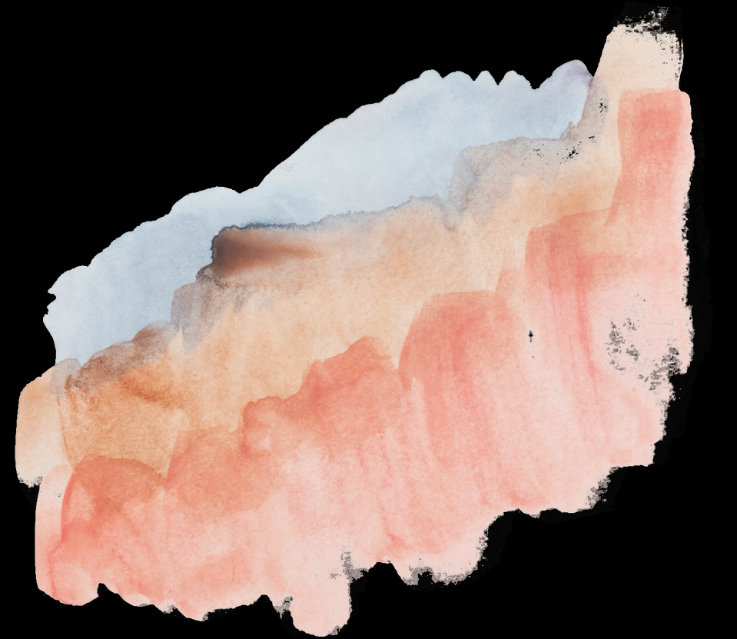
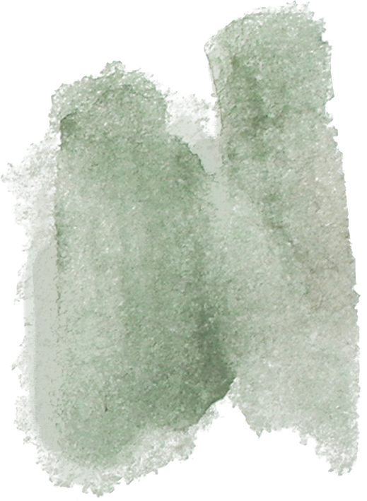
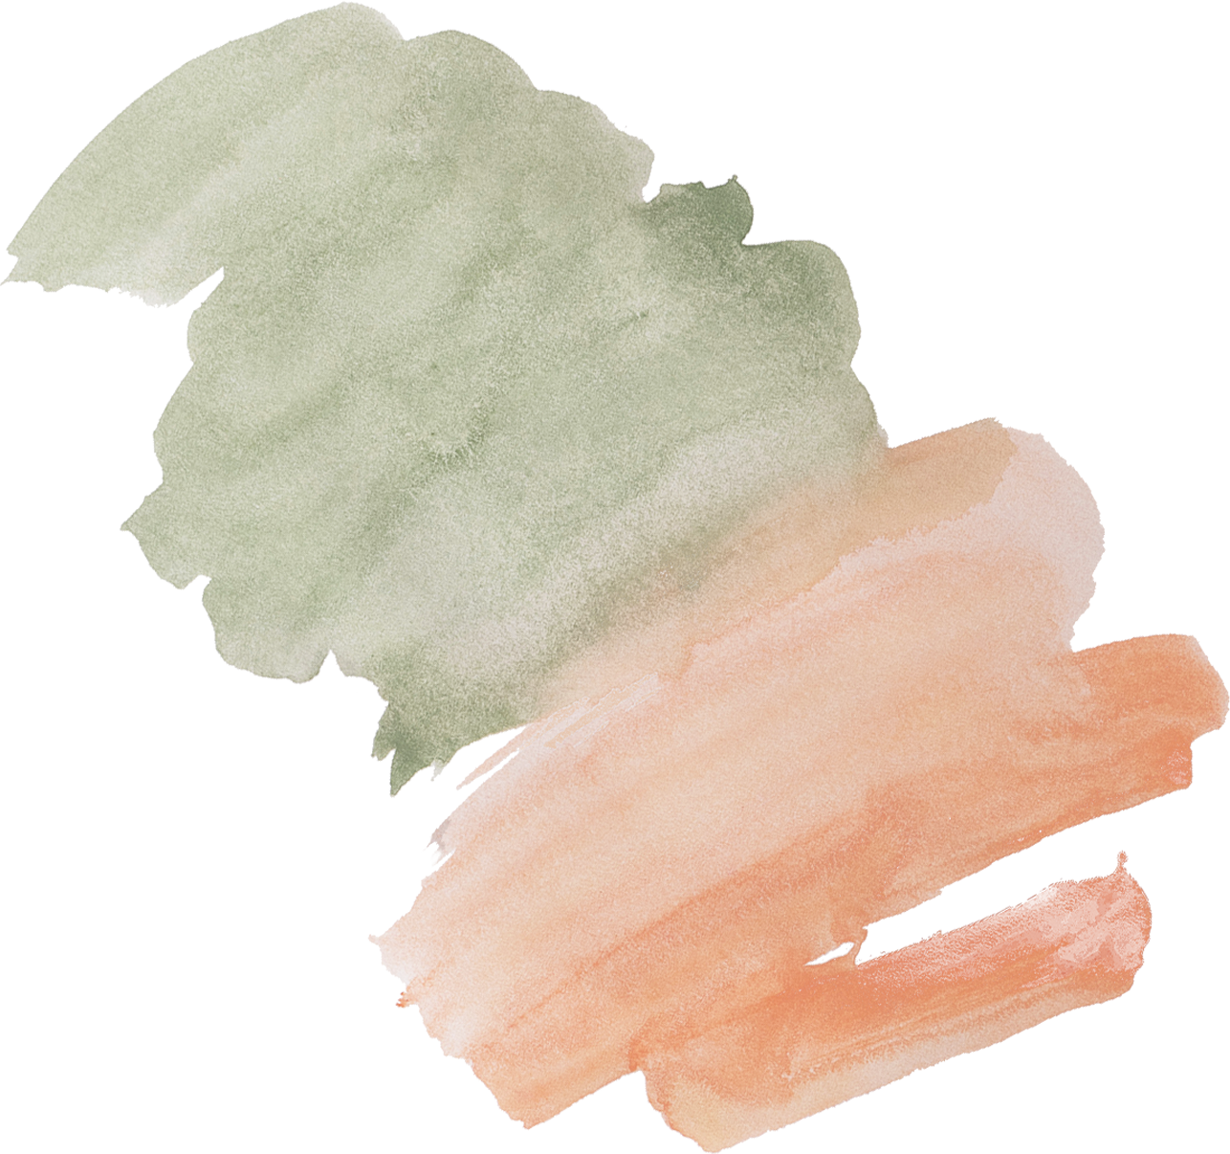


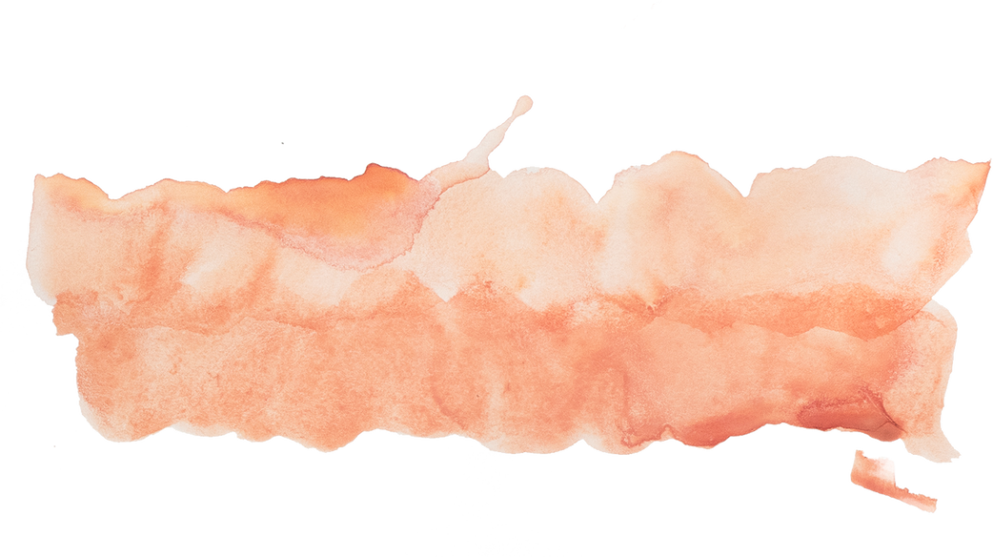

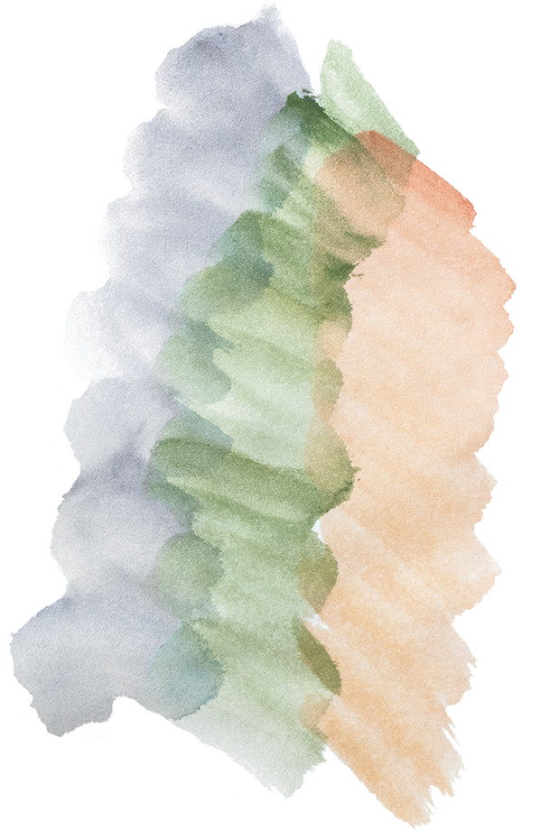



HANGMAN GAME
A Fun and Educational Word Guessing Game

Slide 2
Introduction
Welcome to our presentation on the Hangman game! Hangman is a classic word-guessing game that has been entertaining and educating people of all ages for generations. In this presentation, we will explore the working, uses, advantages, disadvantages, and future scope of our Hangman game project.

Slide 3
Working
The word to be guessed is selected by one player. The guessing player suggests a letter.
01.
Hangman is a word puzzle game where one player thinks of a word and the other player tries to guess it by suggesting letters.
02.
If the letter is in the word, it is revealed; otherwise, a part of a hangman is drawn.
03.
The guessing player continues until they guess the word or the hangman is complete.

Slide 4
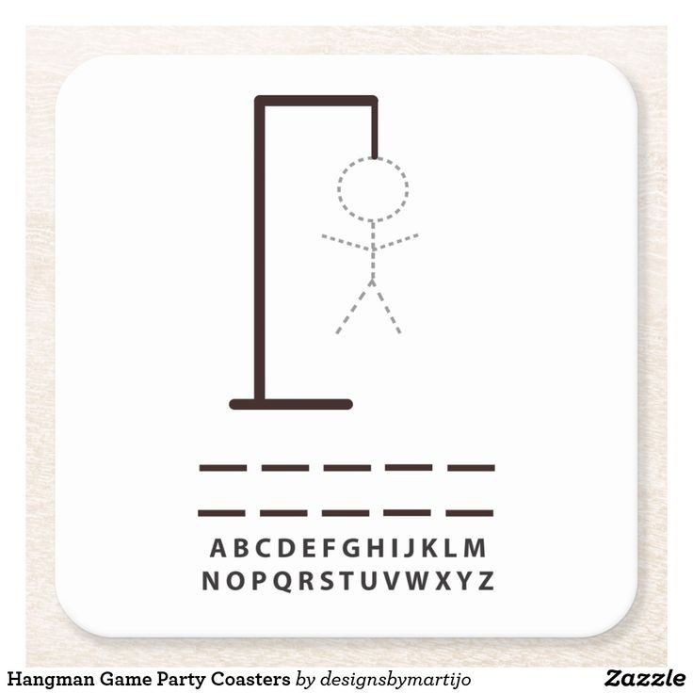

Slide 5

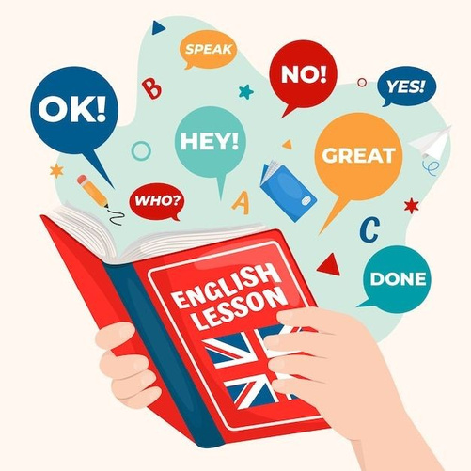

Uses
Cognitive Development: Developing critical thinking and problem-solving skills.
Language Learning: Enhancing language skills in a playful manner.
Educational: Improving vocabulary and spelling skills.

Slide 6
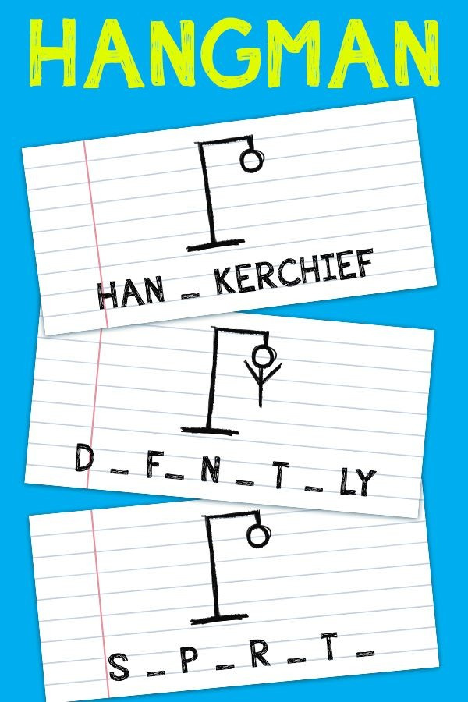
Advantages
Hangman comes with several advantages, such as:
- Educational Value: Enhances language and cognitive skills.
- Accessibility: Can be played offline or online.
- Versatility: Suitable for individuals and groups.
- Creativity: Encourages word choice and creativity.

Slide 7
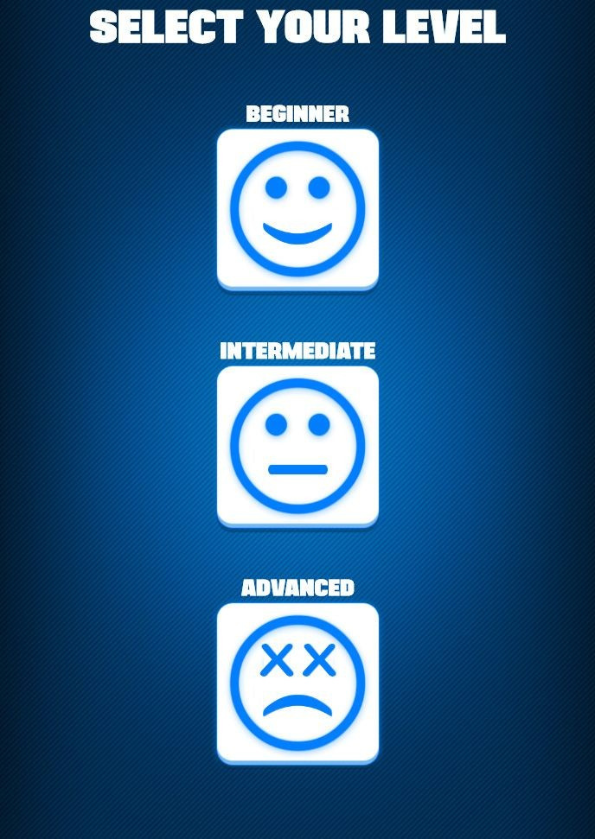
Disadvantages
Hangman has some limitations, including:
- Limited Vocabulary: The game's quality depends on the chosen words.
- Inclusivity: Some words may be challenging for non-native speakers.
- Subjectivity: Interpretation of drawings can vary.

Slide 8
Future Scope
01
02
03
04
Mobile Apps: Creating mobile versions for on-the-go gaming.
Multiplayer Options: Expanding the game for online multiplayer.
Thematic Versions: Customizing the game with various themes (e.g., geography, science).
Educational Features: Integrating word lists and definitions for learning.

Slide 9
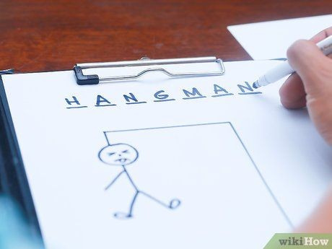
Conclusion
Hangman is a timeless and versatile word-guessing game that combines entertainment and education. It offers numerous advantages and can be further developed to meet the evolving needs of players. We hope you've enjoyed our presentation and gained a better understanding of the Hangman game.

Slide 10
THANK YOU!

